Slide 1

PERCEPTRON
By
KIET Group of Institutions

Slide 2
PERCEPTRON
The perceptron is a classification algorithm. Specifically, it works as a linear binary classifier. It was invented in the late 1950s by Frank Rosenblatt.
The perceptron basically works as a threshold function — non-negative outputs are put into one class while negative ones are put into the other class.

Slide 3
Perceptrons:
inputs
w₁
weights
x₁
w₂
output
activation
Σ
y
x₂
.
.
.
θ
a=^{n}Σ_{i=1} w_{i} x_{i}
w_{n}
x_{n}
Xi’s range: [0, 1]
1 if a ≥ θ
y=
0 if a < θ
{

Slide 4
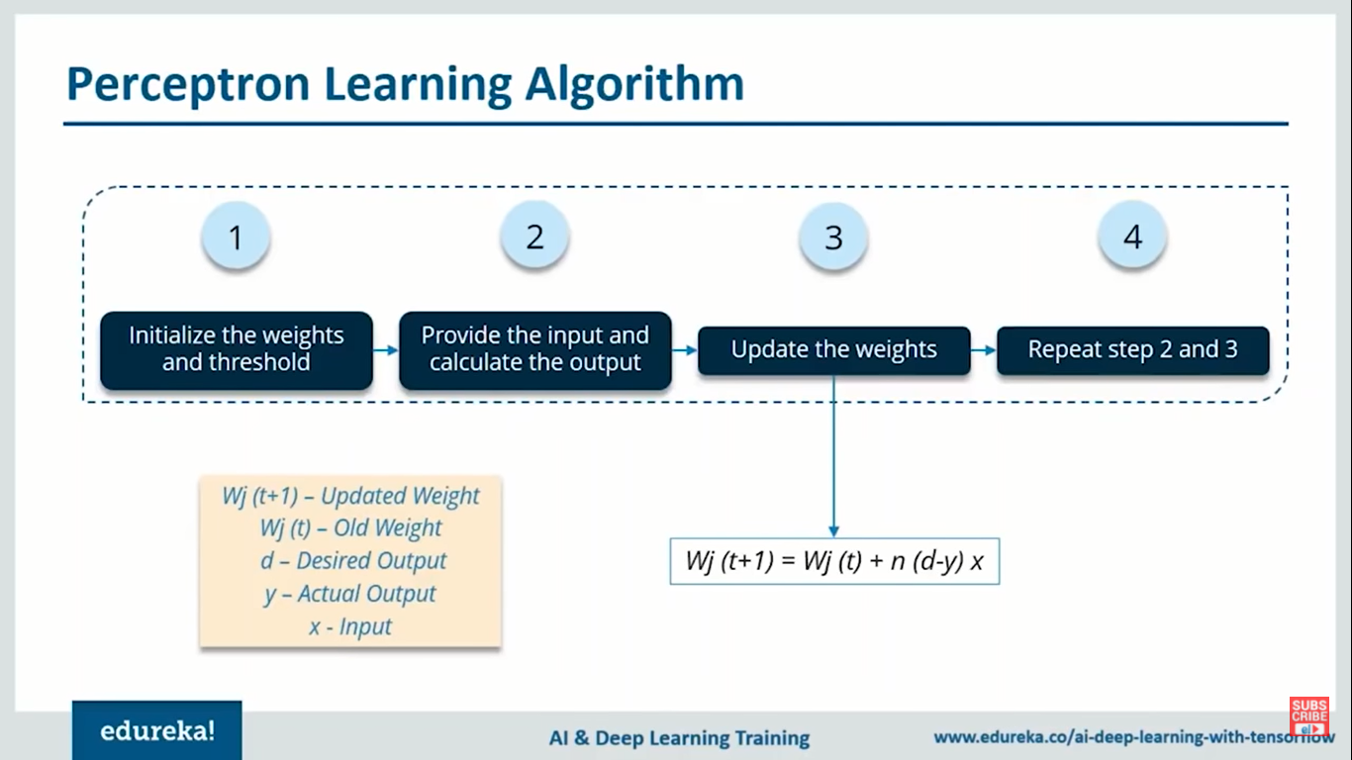
PERCEPTRON LEARNING ALGORITHM
Update the weight in order to reduce the loss or in order to reduce the difference between the actual output and desired output

Slide 5
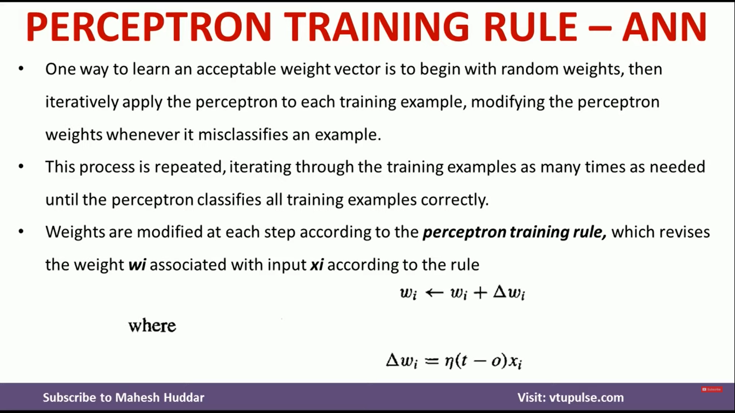
PERCEPTRON TRAINING RULE
One way to learn an acceptable weight vector is to begin with random weights, then iteratively apply the perceptron to each training example, modifying the perceptron weights whenever it misclassifies an example.
This process is repeated, iterating through the training examples as many times as needed until the perceptron classifies all training examples correctly.
Weights are modified at each step according to the perceptron training rule, which revives the weight wi associated with input xi according to the rule.

Slide 6
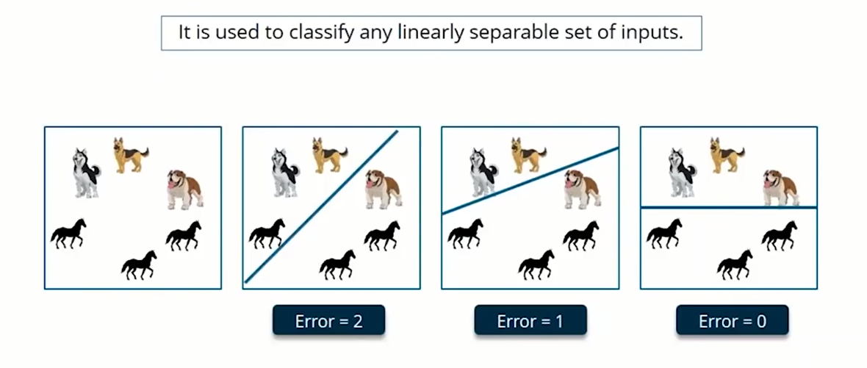
Example

Slide 7
To be learned: W_{i} and
θ
1
1
Decision line
w₁ x₁ + w₂ x₂ = θ
x₂
w
1
0
0
0
x₁
1
0
0

Slide 8
Converting To
(1)
(2)
(3)
(4)
(5)

Slide 9
Threshold as Weight: W₀
x₀=-1
x₁
w₁
w₀ =θ
w₂
x₂
Σ
y
.
.
.
^{n}
a= Σ_{i=0} w_{i} x_{i}
w_{n}
{
1 if a ≥ 0
y=
0 if a <0
x_{n}

Slide 10
Training the Perceptron
Training set S of examples {x,t}
x is an input vector and
T the desired target vector (Teacher)
Example: Logical And
Iterative process
Present a training example x , compute network output y , compare output y with target t, adjust weights and thresholds
Learning rule
Specifies how to change the weights W of the network as a function of the inputs x, output Y and target t.
x₁ | x₂ | t
0 | 0 | 0
0 | 1 | 0
1 | 0 | 0
1 | 1 | 1

Slide 11
Perceptron Learning Rule
w_{i} := w_{i} + Δw_{i} = w_{i} + α (t-y) x_{i} (i=1..n)
The parameter α is called the learning rate.
In Han’s book it is lower case L
It determines the magnitude of weight updates Δw_{i} .
If the output is correct (t=y) the weights are not changed (Δw_{i} =0).
If the output is incorrect (t ≠ y) the weights w_{i} are changed such that the output of the Perceptron for the new weights w’_{i} is closer/further to the input x_{i}.

Slide 12
Perceptron Training Algorithm
Repeat
for each training vector pair (x,t)
evaluate the output y when x is the input
if y≠t then
form a new weight vector w’ according
to w’=w + α (t-y) x
else
do nothing
end if
end for
Until fixed number of iterations; or error less than a predefined value
α: set by the user; typically = 0.01

Slide 13
Example: Learning the AND Function : Step 1.
W₀ | W₁ | W₂
0.5 | 0.5 | 0.5
x₁ | x₂ | t
0 | 0 | 0
0 | 1 | 0
1 | 0 | 0
1 | 1 | 1
a=(-1)*0.5+0*0.5+0*0.5=-0.5,
Thus, y=0. Correct. No need to change W
α: = 0.1

Slide 14
Example: Learning the AND Function : Step 2.
x₁ | x₂ | t
0 | 0 | 0
0 | 1 | 0
1 | 0 | 0
1 | 1 | 1
W₀ | W₁ | W₂
0.5 | 0.5 | 0.5
a=(-1)*0.5+0*0.5 + 1*0.5=0,
Thus, y=1. t=0, Wrong.
ΔW₀= 0.1*(0-1)*(-1)=0.1,
ΔW₁= 0.1*(0-1)*(0)=0
ΔW₂= 0.1*(0-1)*(1)=-0.1
α: = 0.1
W₀=0.5+0.1=0.6 W₁=0.5+0=0.5
W₂=0.5-0.1=0.4

Slide 15
Example: Learning the AND Function : Step 3.
x₁ | x₂ | t
0 | 0 | 0
0 | 1 | 0
1 | 0 | 0
1 | 1 | 1
W₀ | W₁ | W₂
0.6 | 0.5 | 0.4
a=(-1)*0.6+1*0.5 + 0*0.4=-0.1,
Thus, y=0. t=0, Correct!
α: = 0.1

Slide 16
Example: Learning the AND Function : Step 4.
x₁ | x₂ | t
0 | 0 | 0
0 | 1 | 0
1 | 0 | 0
1 | 1 | 1
W₀ | W₁ | W₂
0.6 | 0.5 | 0.4
a=(-1)*0.6+1*0.5 + 1*0.4=0.3,
Thus, y=1. t=1, Correct
α: = 0.1

Slide 17
Final Solution:
x₂
w₁=0.5
w₂=0.4
w₀=0.6
0
1
x₁
a= 0.5x₁+0.4*x2 -0.6
0
0
^{n}
1 if a ≥ 0
y=
0 if a <0
{
Logical AND
x₁ | x₂
0 | 0
0 | 1
1 | 0
1 | 1
y
0
0
0
1

Slide 18
Example: TRY THIS FOR OR FUNCTION
W₀ | W₁ | W₂
-0.5 | -0.5 | -0.5
x₁ | x₂ | t
0 | 0 | 0
0 | 1 | 1
1 | 0 | 1
1 | 1 | 1
Let x0 = 1
α: = 0.1

